Slide 1
DSA3101 Assignment 1
Group 2
Ahmad As-Shodiqqul Amin (A0201627N)
Dione Lim Yee Sze (A0206307N)
Kellie Chin Shu Wen (A0205467A )
Keith Tay Xiang Rui (A0204695Y)
Lua Jun An (A0206136N)
Ni Hui Ling (A0204943H )
Timothy Wong Hoey Pheen (A0196615W)
Tu Zhehao (A0200130M )

Slide 2
Outline
Context & Problem
Objective
Approach
Evaluation

Slide 3

Context:
Loan Default

Slide 4






What Constitutes A Loan Default?
Bob

Slide 5
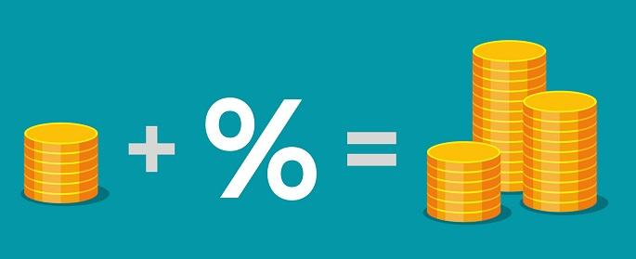
How Do Banks Earn?
But...
>>>
Interest
HOW?

Slide 6
%
Every Bank’s Objective
False Positives
False Negatives
Reduce Default Rates
Prevent Potential Non-Defaulters From Being Rejected

Slide 7


False Positive Example
6 months later
Initial Approval By The Bank
Running off without paying

Slide 8


False Negative Example
6 months later
Potentially Approved
Initial Rejection by the Bank
Ready to Pay

Slide 9
Objective

Slide 10

Objective
Reject individuals at high risk of defaulting
Ensure individuals capable of repaying are not rejected

Slide 11
Deep Data Dredge
Problems | Solutions
Irrelevant Columns | Removal based on intuitive relevance
Columns using Normalized Values | Deletion due to lack of information
Columns with High Collinearity | Elimination depending on metrics
Columns with Missing Values | Erase referencing to threshold of 25%
Padding remaining empty entries | Sampling from existing data points

Slide 12
Diving into Our Data

Slide 13


7 Key Insights

Slide 14

1
2
More children, more difficulty repaying
More likely for males to default
3
Credit amount no significant effect on default
4
Widows lowest likelihood of default
5
Default rates decreases with age
7
Highest proportion of defaulters took up loans of 300k - 600k
6
Revolving loans default rate is less than cash loans

Slide 15
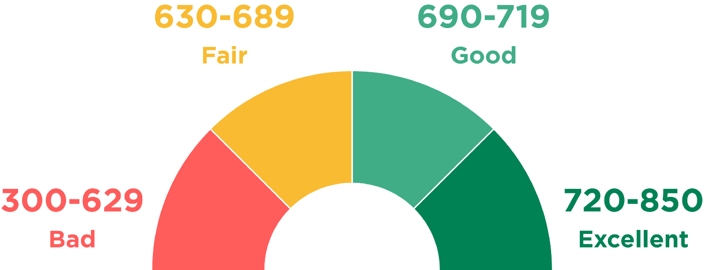
Credit Scoring
What Is A Credit Score?

Slide 16

How Do We Calculate A Credit Score?
Useful Attributes
Information Value
> 0.02
Attributes

Slide 17

How Do We Calculate A Credit Score?
Useful Attributes
Weight of Evidence
Information Value
> 0.02
Credit Score
Attributes

Slide 18
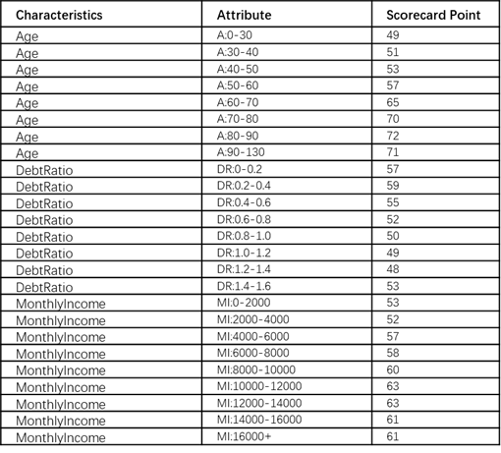
Example Of A ScoreCard
Name: Bob
Age: 25 Debt Ratio: 0.5
Monthly Income: $5,000
Credit Score:
49 + 55 + 57 = 161

Slide 19

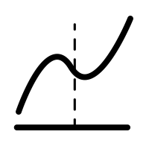




Our Approach

Slide 20
F1 Score | 74.6%
Recall | 77.6%
Precision | 71.8%
Accuracy | 73.5%

Slide 21
Approach

Slide 22


APPROACHES
Greater approval rate by lowering loan amount given to clients
Providing better repayment process for younger adults

Slide 23
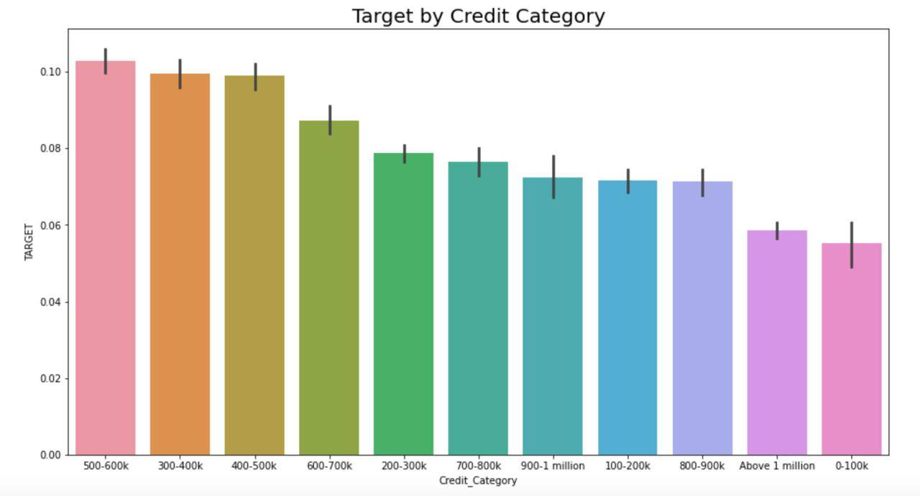


Approach 1:
Greater approval rate by lowering loan amount given to clients
Based on Insight 7: Highest proportion of defaulters are those that have loans of $300k - 600k
Rejection = Loss in Potential Gains

Slide 24
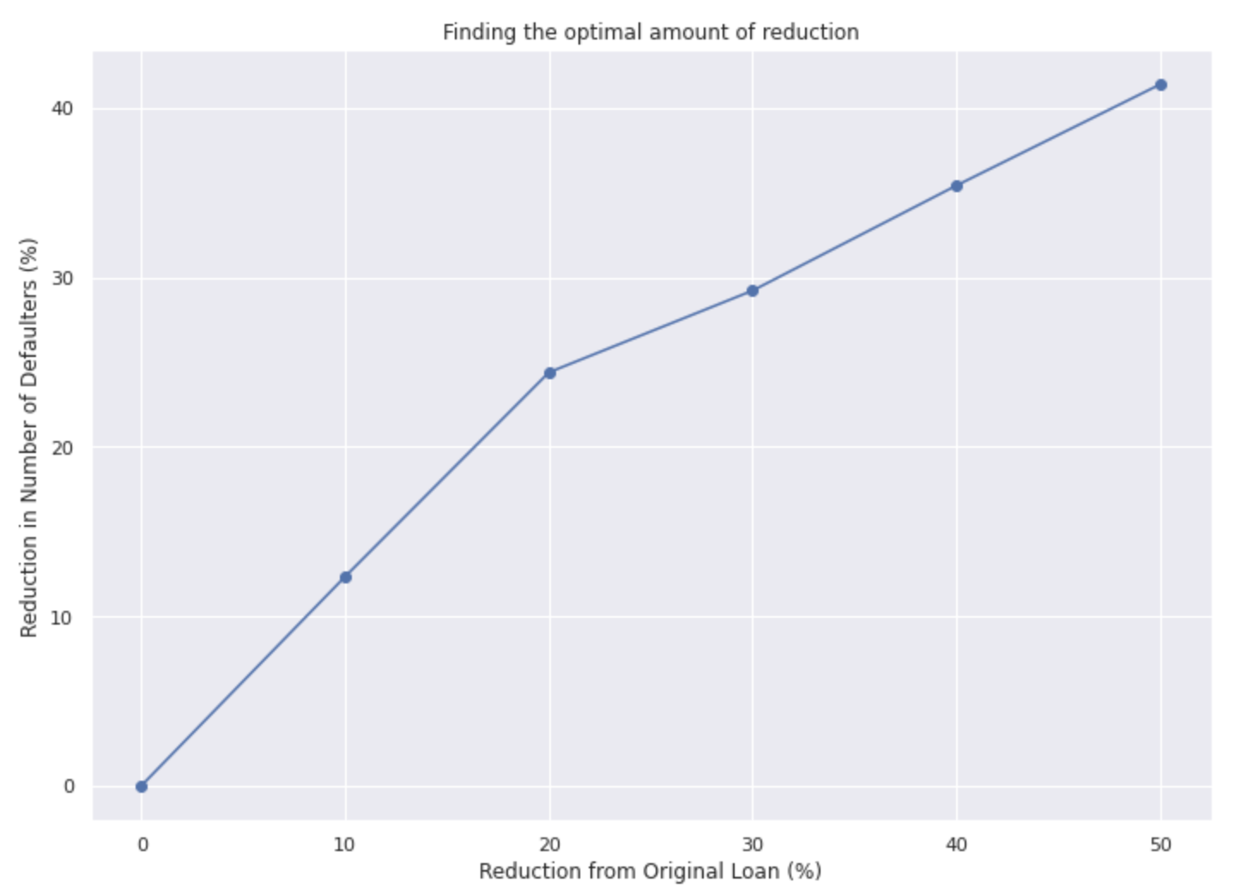

Approach 1:
Greater approval rate by lowering loan amount given to clients
Key Considerations
Too much reduction will not motivate client to take up loan
Too little reduction will not benefit bank or incentivise client
Lower loan amount by: 20%
20
Notes:
Insert animation here

Slide 25
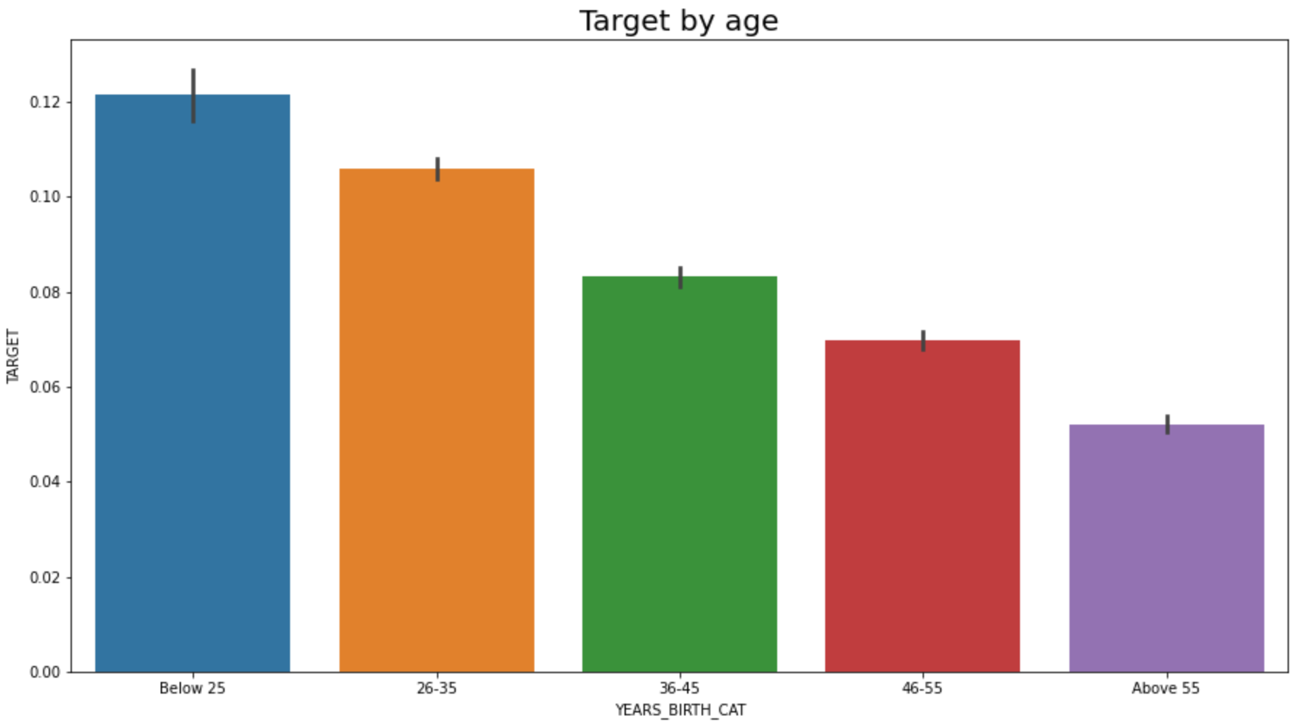

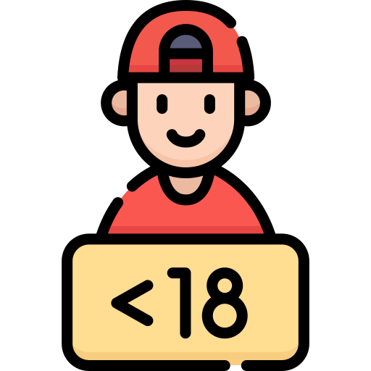
Approach 2:
Providing better repayment process for younger adults
Based on Insight 4: Positive correlation between age and ability to repay a loan
Highest number of defaulters among age groups: ‘Below 25’
25

Slide 26
Approach 2:
Providing better repayment process for younger adults
Entering Workforce
Tuition Loans
Less Financial Experience
Based on Insight 4: Positive correlation between age and ability to repay a loan
Highest number of defaulters among age groups: ‘Below 25’
Why?
25
Notes:
https://fraser.stlouisfed.org/files/docs/historical/frbrich/econbrief/frbrich_eb_13-12.pdf

Slide 27



Approach 2:
Providing better repayment process for younger adults
Extend Repayment Period
Impose Scaled Interest Rate
Notes:
https://fraser.stlouisfed.org/files/docs/historical/frbrich/econbrief/frbrich_eb_13-12.pdf

Slide 28
Evaluation

Slide 29
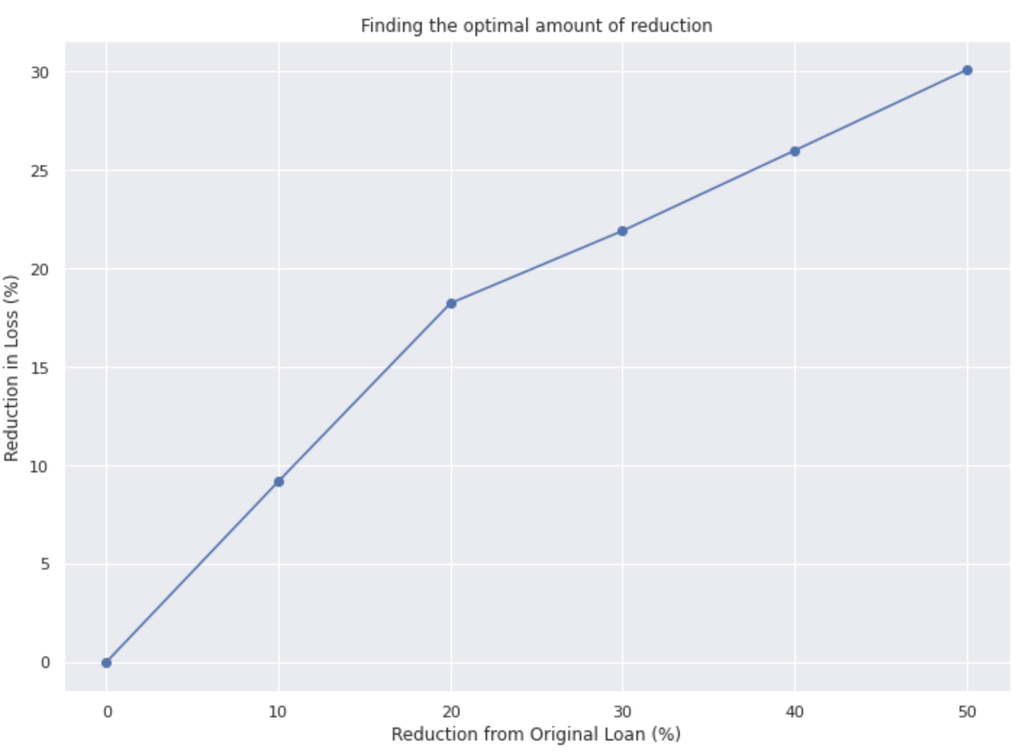
Evaluating Approach 1:
Greater approval rate by lowering loan amount given to clients
18.23%
Lowers potential losses by $762,597,495.00 (18.23%)

Slide 30
Evaluating Approach 2:
Providing better repayment process for younger adults
Extend Repayment Period
Impose Scaled Interest Rate
Increase in Interest Income by $393,106,511.23 (8.03%)

Slide 31
Conclusion

Slide 32
Thank You
Q & A

